Slide 1
Building Communication and Teamwork Skills in Your Academy Classes
Pam Goldman & Monica Lobbestael
Cordova HS Polytech Academy

Slide 2
Outline
Ice Breaker Activity
Why do we care?
Elbow Buddies
Team and Communication Building Activity’s Structure
Activities
Getting to Know You
Communication Builders
Competitive Teams
Cooperative Teams
Summary

Slide 3
Ice Breaker Activity
Personal Preference
Everyone stands at one side of the room
Leader asks an either/or question
Participants move to the side of the line that matches their choice.
Let’s try it!!
Debrief

Slide 4
Why improve teamwork and communication skills?
In School
Students in academies work on projects in teams.
Students who communicate clearly can do better in class (Common Core Standards emphasize this skill)
In the work world
Most careers require the ability to work in a team
Most careers require the employee to clearly communicate with others (customers, bosses, co-workers)

Slide 5
Elbow Buddies
Student picks one buddy to be their “go-to” person.
Student will be assigned a seat beside their EB
Rules
Must pick new person each time
Both students must agree on the pick
Switches every month/chapter/project
If student leaves a blank, the teacher will assign
Teacher may group pairs to form teams

Slide 6
Elbow Buddy Form
Elbow Buddy Selections
My Name: _____________
Buddy #1: _____________
Buddy #2: _____________
Buddy #3: _____________
Buddy #4: _____________

Slide 7
Activity Overview
The goal of the activities is to build the team feeling in your classroom and to improve the students’ communication skills
Introduce the activity
Students may opt-out if they don’t feel comfortable
Do Activity
Teacher should participate
Debrief Activity
Some are competitive, some are cooperative
Need to be able to recognize the difference and work together

Slide 8
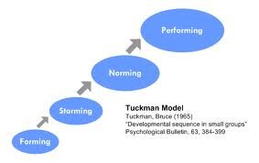
Group Dev. Stages

Slide 9
Get to Know You Activities
Personal Preference *
M&M Activity (S)
Birthday List (NT)
Draw for Understanding (NT) (S) *
Name Duck Goose (T)

Slide 10
Communication Builders
Observation Skills
Back Writing (S) (T) (NT) *
Lego Building (S)

Slide 11
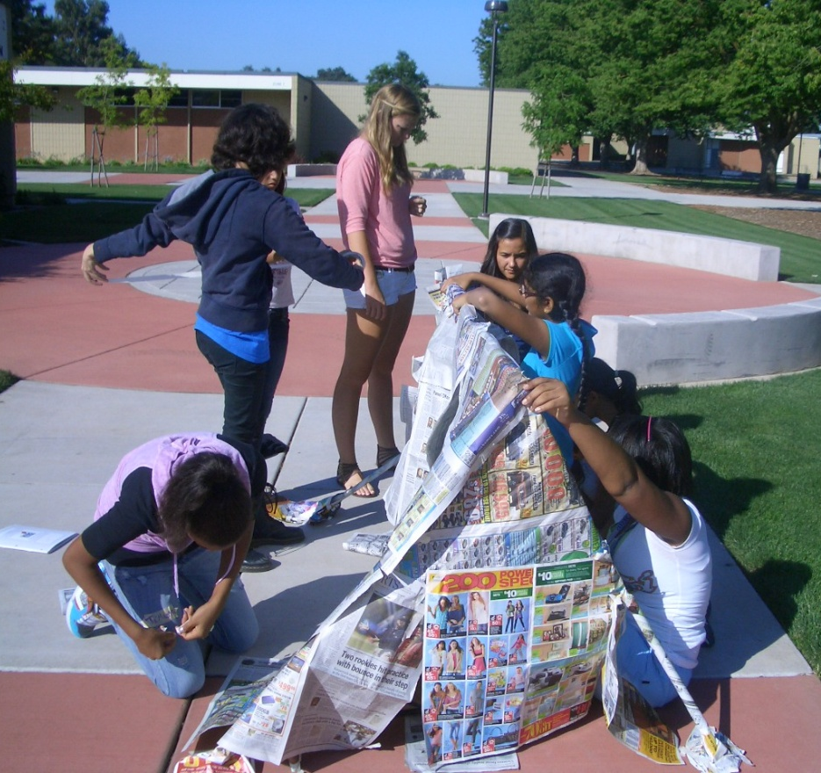
Competitive Team Activities
Shove Off (T) *
Over / Under (S) (T)
Paper Shelter (S) (NT) (T)

Slide 12
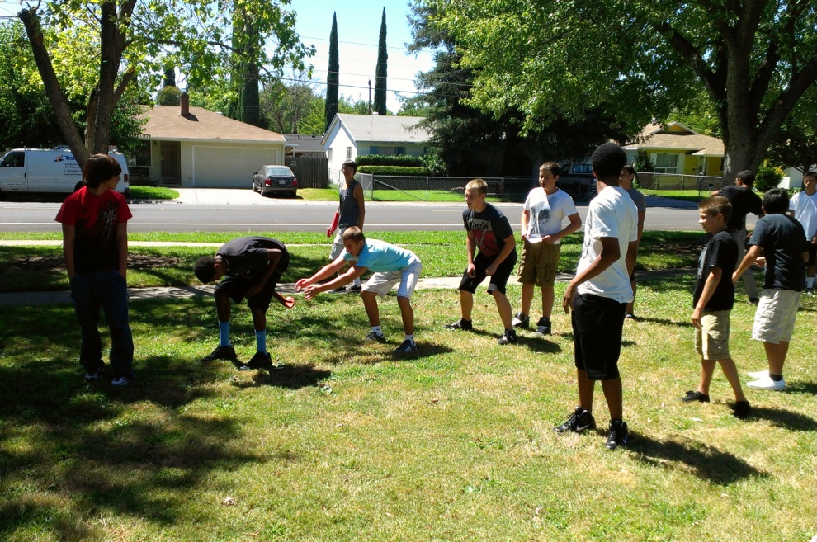
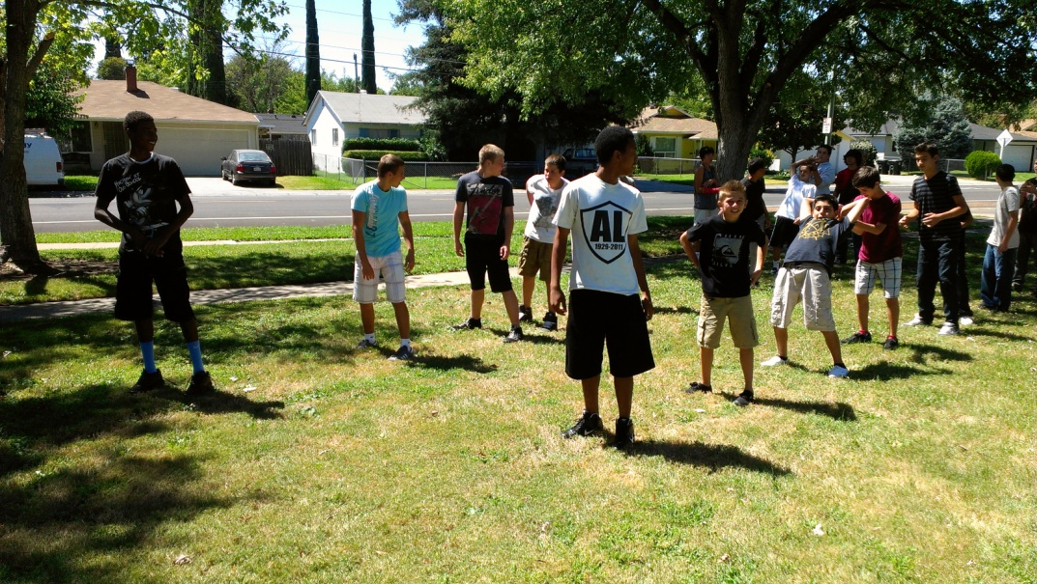
Under Over Game

Slide 13
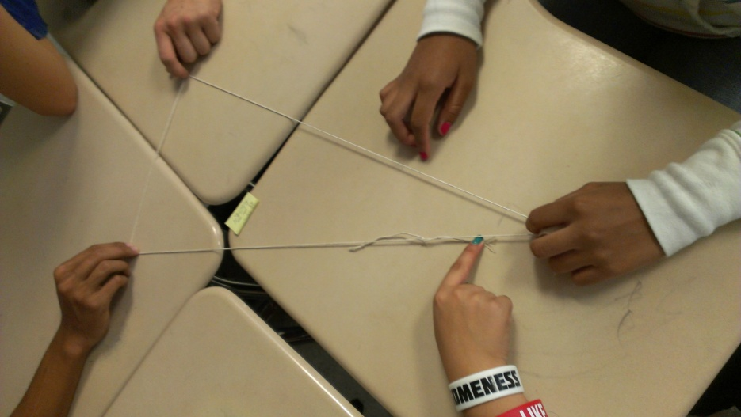
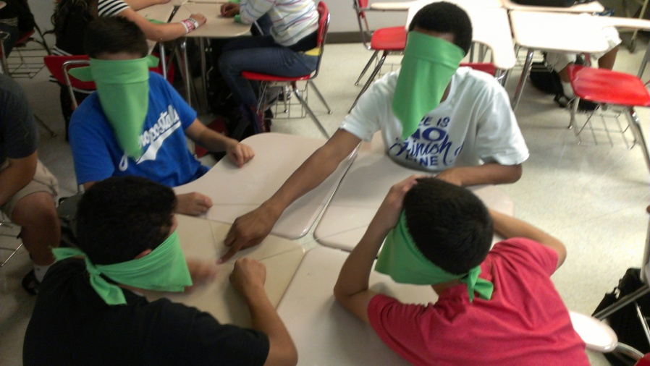
Cooperative Team Activities
Hand to Hip (T) *
Human Knot (T) *
Traffic Jam (S)
Count Off (S) (NS) *
Blind Polygons (S) (NS)

Slide 14
Summary
Team building is a key component for successful academy classes
Builds trust in the classroom
Builds feeling of community and family
Creates a safe and supportive environment
Keeps students engaged and learning
Strong communication keeps classes flowing smoothly.
Ask good questions
Know what you don’t know and get what you need.
Academy students become better employees

Slide 15
Questions?

Slide 16
Credits
Geometry in Construction by Tom Moore & Scott Burke
Project Lead the Way

Slide 17
Backup Activities
Observation Skills
Birthday List (Height first)
Traffic Jam

