Slide 1
Educating for Careers, 2013 Developing a Public Safety Pathway
Mike McColm
Clovis East High School
michaelmccolm@cusd.com

Slide 2
Mike McColm
Married with two little girls (6 and 2)
Worked for Cal Fire, Fresno County, Station 82 for 2 years
BA in Psychology
Currently work with the City of Fowler Fire Department - PCF Captain (13 years)
Teaching at CEHS for 5 years: Emergency Medical Technician, 4
Medical Careers, 5
Firefighting Technology, 3
Assistant football coach 4 years
Selected to UCCI curriculum writing workshop Fall of 2012 for the integration of English and Public Safety (awaiting UC approval)
Presented at JSPAC Conference in Sacrameto.
Served on the State Curriculum Standards Review Committee for both Firefighting and Emergency Medicine

Slide 3
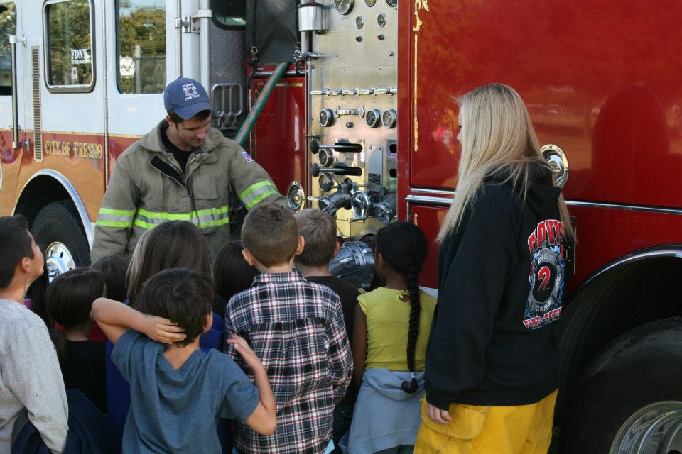
Welcome!
Please feel free to ask any questions as you think of them!
If you would like any of the resources I have, please feel free to let me know today or at your convenience
michaelmccolm@cusd.com

Slide 4
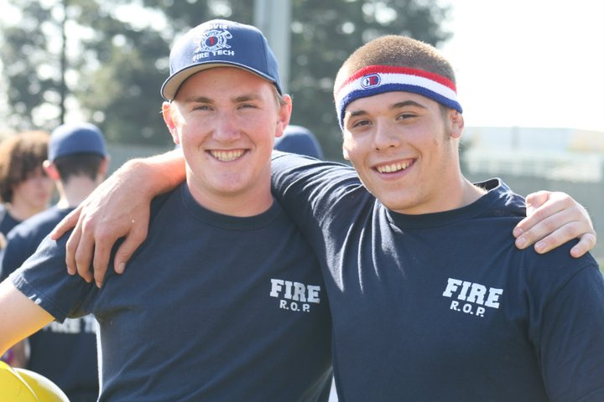
Crunching the numbers
Why are the statistics, %’s, demographics, and numbers so important??

Slide 5
Demographics of Clovis Unified and CEHS
Clovis Unified School Dist
Clovis East High School

Slide 6
First year class make-up: 0% female students 4% Asian students 0% Black or African American
Third year class make-up:
8% female students 16% Asian students
3% Black or African American

Slide 7
Knowing your audience… and who might be missing…
504 plan
ESL students
SED
Male/Female
Ethnic representation

Slide 8
Knowing my audience…
Who are you?
What were you hoping to hear about today?

Slide 9
Looking at one piece of the Public Safety Pathway, Firefighting - Starting a new class from the ground up…
April of 2010 - August of 2010,
Our first thought was filling the seats in the class.
Variables affecting student enrollment: counselors, school sites, students

Slide 10
Some of the hurdles involved:
Text books / Curriculum Map
Equipment / Supplies
Facilities
Support
Planning ahead--thinking BIG!

Slide 11
The Path to Pathway Success… Turning the hurdles into ASSETS!
Curriculum Map
Advisory Committee
Community Members
School Board
School Site
Industry contacts
Social Media!!
Reputation

Slide 12
Keys to a Strong Advisory Committee
Educational Partnerships
Professional Partnerships
Continuing Education Partnerships

Slide 13
Educational Partners
Fresno County Office of Education
Clovis Unified School District: Clovis High School, Clovis East High School, Buchanan High School, Clovis North High School, Clovis West High School, Gateway High School
Fresno City College
Reedley College
Fresno State University
Madera Adult School

Slide 14
Professional Partners
Clovis Fire Department
Fresno Fire Department
U.S. Marshalls Office
Fresno County Sheriffs
US Air Force
Hanford SWAT
American Ambulance
Selma Police Department
Clovis Police Department
Fowler Fire Department
Shaver Lake Fire Department
Cal Fire, Fresno County
Clovis Explorer Program (Fire and Police)

Slide 15
Continuing Education Partnerships
Fresno City College Fire Academy
Reedley College Forestry Department
Madera Adult School Fire Academy
College of the Sequoias
California State University Fresno
CSU System (Homeland Security / Emergency Management)

Slide 16
Creating a needs analysis and gaining support
Where will it all come from??
How much do we need?
How much do we want?
Think BIG!
Support people who cannot be overlooked!
Administration team
Teachers (CTE and Core)

Slide 17
Clovis Fire is the first to make a donation!
6 turnout jackets
8 turnout pants
3 structure helmets
4 non-functioning Blackout SCBA’s

Slide 18
Shaver Lake Volunteer Fire Department
10 Structure Helmets
1 HURST Jaws Unit
15 flashlights
15 sets of wildland turnouts
12 sets of wildland web gear

Slide 19
Fowler Fire
1 Air Chisel
2 extension ladders

Slide 20
Fresno Fire makes us a deal…
We purchased Engine 20 from Fresno Fire for $1
A fully functioning 1992 Beck Pumper
Fully loaded with hoses and nozzles

Slide 21
Cal Fire – Fresno County
22 Sets of structure turnouts

Slide 22
Clovis Fire responds!
32 working SCBA’s
60 extra air bottles
At least $225,000 if we were to purchase this equipment new!

Slide 23
Fowler Fire
1986 Ford F350 – Mini Pumper

Slide 24
Not Pictured
A Police Cruiser donated by Selma Police Department

Slide 25
Madera Fire Academy
50 Structure Helmets
70 Wildland Helmets
100 pairs of structure boots
50 full sets of structure turnouts
Additional curriculum resources
9 vintage SCBAs

Slide 26
Check your phone, email, text, Twitter, Facebook…
30 seconds! Go!

Slide 27
Planning and Mapping a Pathway
Brainstorming
Forward Mapping
Backward Mapping

Slide 28
Pathway Components
Lower grade involvement
Introduction
Concentrator
Capstone
College and Career Ready preparation and skills

Slide 29
Our Example of a Course Map
Introductory:
CERT
Into To Department of Homeland Security and Emergency Management
Concentration Courses:
Wildland Firefighting / First Responder
Emergency Responder, Medical Careers
Law & Justice, Criminal Justice, Criminal Investigation
Capstone Courses:
Firefighting (structural)
EMT
Journey for Justice in America (Gov), Forensic Science Investigation

Slide 30
Pathway Course Mapping Variables
Target age group
Gender
Socioeconomics
Cultural demographics
Student achievement level
Articulation
Dual credit
Student population base

Slide 31
How to connect and reach students???
What are some way you can reach out to new students?

Slide 32
Using “Peer Pressure” to your advantage!
Second year firefighting students recruiting the current sophomore class at Clovis East

Slide 33
Social Media
Word of mouth is one of the fastest ways to spread the word (good or bad).

Slide 34
Utilizing Nontraditional/Minority Professional Partners
Guest Speakers
Female Fire Investigator, Fresno Fire
Female Fire Captain, Fresno County Fire
Ethnic diversity through various guest speakers

Slide 35
Transitioning from “Survival Mode” to “Anticipation Mode” when building a pathway or new class
Most teachers would get fired for doing what I do with my students every day! And they LOVE IT!

Slide 36
Utilizing what already exists!

Slide 37
Finding ways to excite and engage students!
Career Skills Challenge
Public Safety Expo @ CE

Slide 38
Course Validation
2+2 Articulation (Community College)
Occutrack (Community College)
Unitrack (University)
A-G Certification (UC)
Industry Certifications

Slide 39
Educational Partnerships: College Credit
Currently have in place:
2+2 Articulation with Fresno City College, Fire Academy
2+2 Articulation with Fresno City College, EMT Program
2+2 Articulation with Fresno City College, Nursing Program
2+2 Articulation with Fresno City College, Crime Scene Investigation
2+2 Articulation with Fresno City College, Criminal Justice
UC “A” Government, Juvenile Justice in America
In Progress:
Occu-track agreement with Fresno City College Firefighting, Medical Careers, CSI, and Criminal Justice
Uni-track agreement with CSU Fresno for EMT and DHS

Slide 40
Certifications Available to the students:
FEMA
NWCG
NFA online
CPR/First Aid

Slide 41
Course Description / Outline / Competencies
Educational Map – gold standard
Clearly outlined goals and expectations (ESLRs) Expected Student Learning Results
Update regularly

Slide 42
Effectively Reaching Special Populations Students
ESL, nontraditional gender, SED, 504
Create a nontraditional learning environment
Fun, engaging, interactive, spontaneous, promote critical thinking

Slide 43
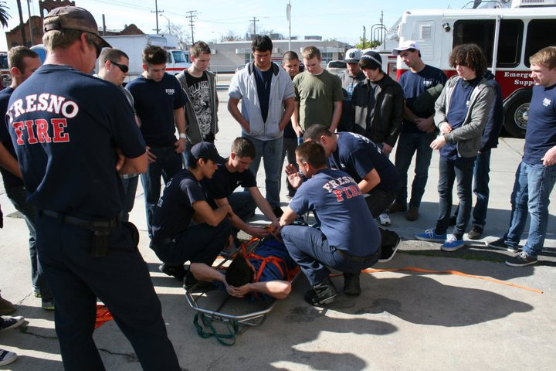
Employability Skills
Resume
Job Application
Interview
Interview Review

Slide 44
Common Core State Standards in 2014
New Assessment techniques in 2014:
Selected Response:
multiple choice, less weighted, computerized
Constructed Response:
short answer essay, paragraph responses
Performance Task Assessment:
reading a text, discussing with others, answering questions, and then writing an essay
may involve doing research and then writing an essay

Slide 45
How Common Core can benefit CTE courses, and how CTE can benefit Common Core
Common Core benefits CTE:
Reading 30% fiction and 70% nonfiction (in a student’s day)
Group work will involve all students at all levels at all times
CTE benefits Common Core:
Incorporates: reading, writing, research, speaking, listening and language.
Reading: annotation (active reading) mark up the pages!
Prepares students for college and career readiness.
Specific writing: report writing, event summaries, narratives, legal documents, PCR…

Slide 46
Why is CTE important??
•The average high school graduation rate for students concentrating in CTE programs is 90.18 percent compared to a national graduation rate of 74.9 percent.
•70% of students concentrating in CTE areas stayed in post-secondary education or transferred to a four-year degree program, compared to an overall average state target of 58%.
Resources: U.S Dept. of Ed. (2007) & UC Riverside Report (2011)
UC Riverside Longitudinal Report ( 2006)

Slide 47
A little fire humor…

