Slide 1
Welcome Introduction to Computer Science using Alice Please take a handout!
Erik Amerikaner
Oak Park High School
Oak Park, California
emerikaner@oakparkusd.org
computerteach@roadrunner.com
http://erikamerikaner.com
Notes:
Show videos at beginning.

Slide 2
Alice 2.2 Videos
Let’s watch some videos

Slide 3
We will show you today
Why use Alice as an Introduction to Computer Science
Background of Alice
How to access and install the Alice program
How to run the Alice program
Alice online resources
Tutorials and examples of Alice worlds your students can use immediately.
Alice Learning Materials, Projects, and Assessments

Slide 4
Erik Amerikaner’s Background
National Board of Teaching Standards in Career and Technical Education- Information Technology
Microsoft Certified Professional
Microsoft Master Instructor Office 2007/2010
AP Computer Science and Advanced Office Applications teacher at Oak Park High School, Oak Park, CA.
High School Webmaster and Teacher Trainer

Slide 5
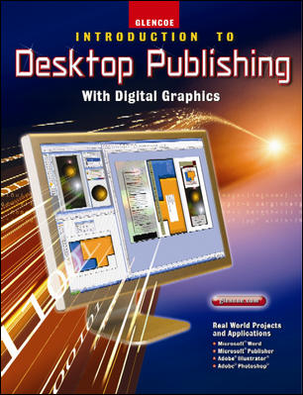
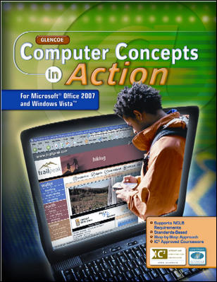
Erik Amerikaner’s Background
Co-author/reviewer for
Glencoe/McGraw-Hill Publishing
Pearson Higher Education
John C. Wiley

Slide 6
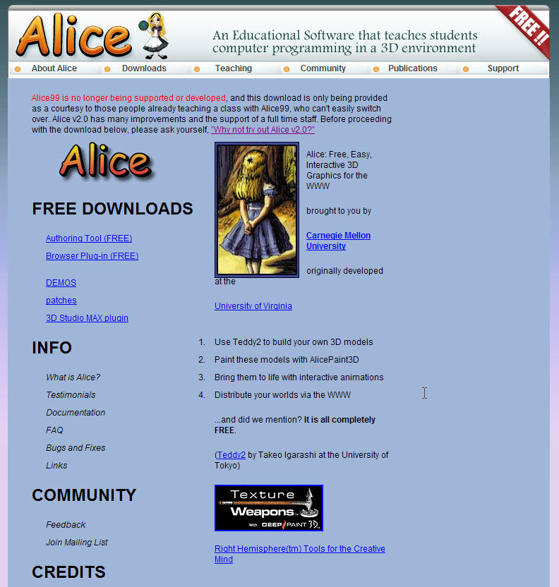
History of Alice
Developed in response to decline of CS majors and especially the decline of women in CS Careers.
Developed at Carnegie Mellon University and the University of Virginia in 1999
Refreshed in 2004 and 2009
Alice 2.2 released in 2009-
Improved video
Alice 3.2 released fall, 2012

Slide 7
Alice.org
Teaching Materials
Download Alice 3.x
Community
Forums

Slide 8
Alice 2.2 Download Screen

Slide 9
Alice Community Forums
Notes:
You can read the posts, but cannot add to the conversation without registering.

Slide 10
Alice in the Welcome Screen

Slide 11
Alice Student Tutorials

Slide 12
Alice Tutorials- continued
Notes:
This tutorial has sound. The students use headphones to listen.

Slide 13
Examples of Alice Worlds

Slide 14
Alice 2.0 Shelly Cashman

Slide 15
Alice 2.0 S/C Student Files

Slide 16
Alice 2.0 Faculty Files
Instructor’s Manual
Syllabus
PPT Presentations
Solutions
Test Bank

Slide 17
Alice 2.0 PowerPoint Files

Slide 18
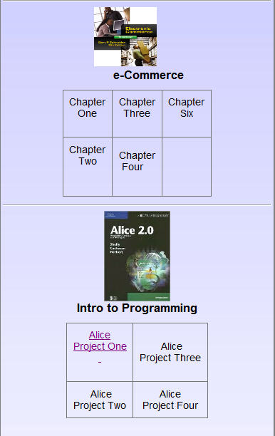
Alice 2.2 ExamView on my website
Click here to open exam

Slide 19
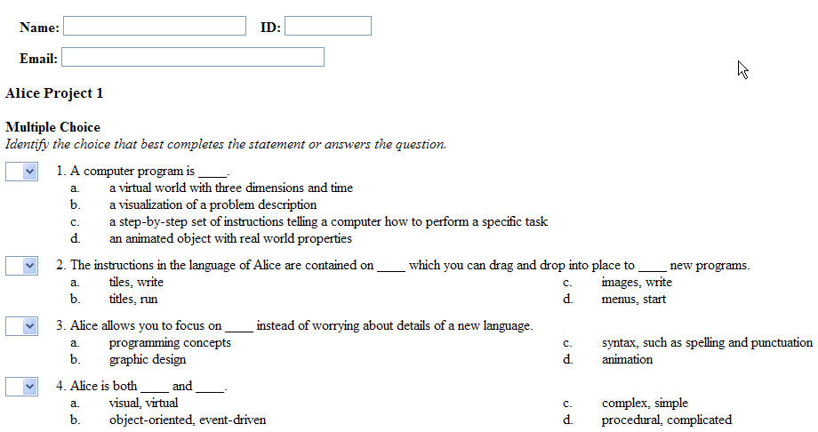
Alice 2.2 ExamView Test online

Slide 20
Alice 2.2 ExamView Test
Click to submit

Slide 21
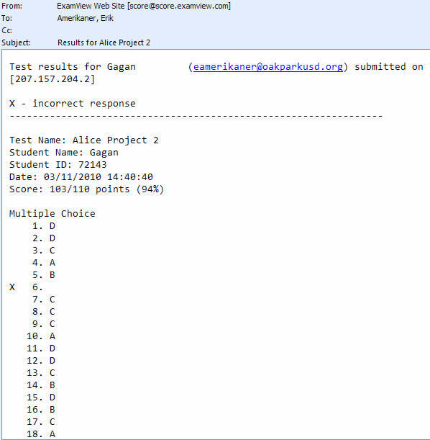
Alice 2.2 ExamView Result

Slide 22
Dick Baldwin Resources http://www.dickbaldwin.com/tocalice.htm

Slide 23
Barb’s Ericson’s Resources
I have been doing webinars on Alice and have materials that go along with the webinars at http://home.cc.gatech.edu/TeaParty/65. You will be asked for a user-id and a password or a key. Just enter a key of brillig.
I also have short videos at http://home.cc.gatech.edu/TeaParty/57.
You are welcome to use my materials. Just keep my name on them.
Thank You,
Barb Ericson

Slide 24
Resources
Alice.org
Shelly-Cashman Introduction to Alice 2.0
Shelly-Cashman Faculty Link
Dick Baldwin
Barb Ericson
Computer Science Teachers Association
Notes:
Go Live to Alice.org

Slide 25
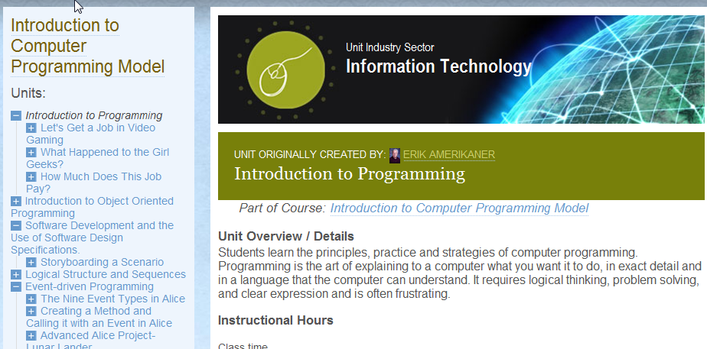
CTEonline.org

Slide 26
Oracle Academy-FREE Training

Slide 27
Microsoft DreamSpark
Notes:
Go Live to Alice.org

Slide 28
Resources cont’d
Link to Newsletter
ncwit.org
itpossibilities.org

Slide 29
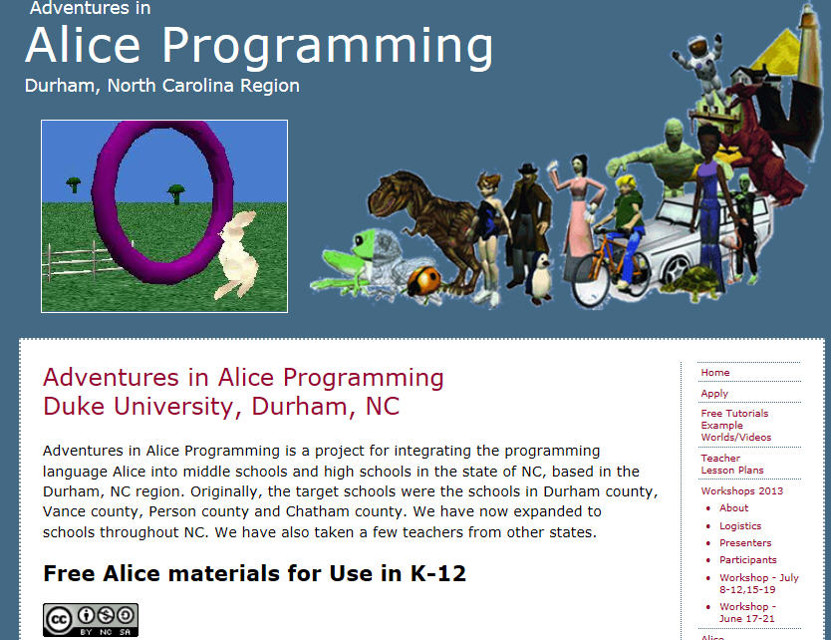
Summer Conferences 2013
Web site Link

Slide 30
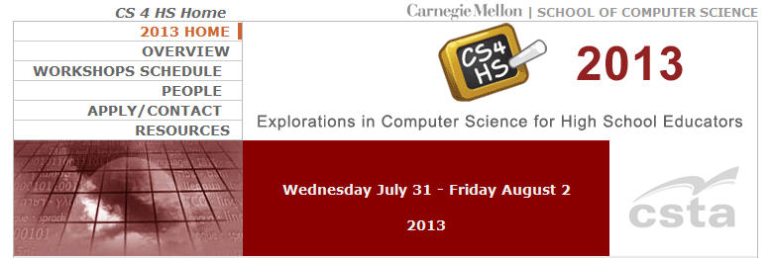
Summer Conferences 2013
Web site Link

Slide 31
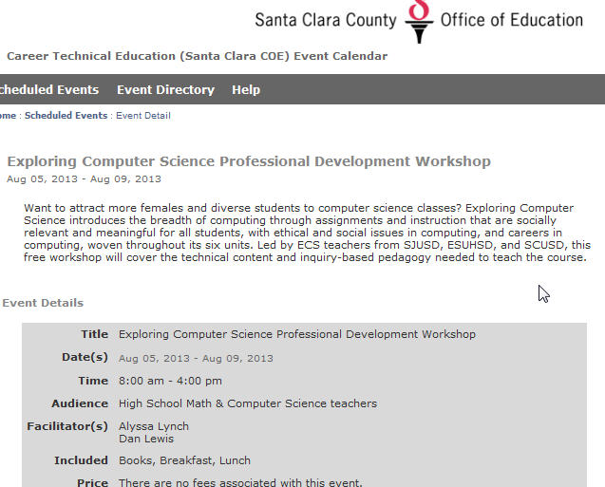
Summer Conferences 2013
Web site Link

Slide 32
Let’s Tour Alice

