Slide 1

YEP – It Works!
Israel Dominguez, Director, Business & Entrepreneurship Center
Sue Coupland, CA$H Business Academy, Lompoc High School

Slide 2
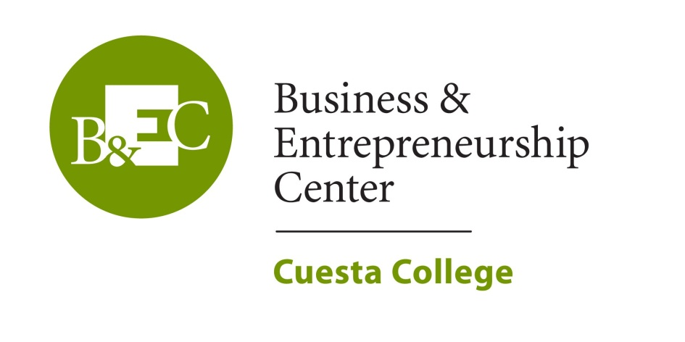

Youth Entrepreneurship Program funding provided by

Slide 3

SB 70/CTE Young Entrepreneurs Project (YEP) Objectives
Identify target Audience
Understand the needs of youth in the region
Create solutions that meet those needs

Slide 4



Student Outcomes
Prepare students to think critically
Communicate effectively
Engage in simulated business endeavors
Respect individuals
Teach business ethics
Understand basics of work environment

Slide 5

Youth Outreach by the BEC at Cuesta College
Classroom presentations
Student competitions
Microloan program
Local job fair for youth
High School visits to Cuesta College
Provided flashdrives to 1,000 students

Slide 6

San Luis Obispo and Northern Santa Barbara County High Schools Outcomes
Classroom presentations to 1,667 students in the region
Pretest and Posttests were given showing a 150% avg. improvement in correct answers

Slide 7

Outreach on the Central Coast
Youth and Young Adults
(ages 14-27 )
  Paso Robles High School
  Atascadero High School
  Arroyo Grande High School
  Righetti High School
  Lompoc High School
  Santa Ynez High School
  Chalk Mountain Community School
  One Stop Career Center for Youth

Slide 8


Presentations to High Schools
Career Exploration
& the Entrepreneur
Financial Literacy 101 and How to Start Your Own Business

Slide 9
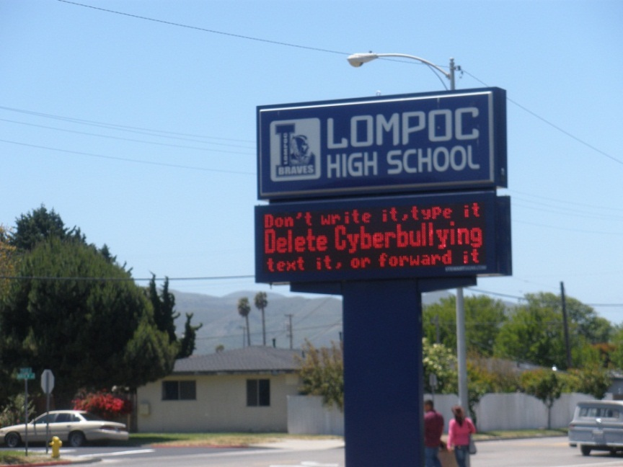
Lompoc High School CA$H Academy
    Career Exploration (January)
    College visit and tour (March)
    Financial Literacy (April)
    Mini-Grant of $1,200
    Student Competition Judging for NFTE (April)
    New Venture Challenge at SBCC (May)
    Microloan project (May)
    Advisory Committee (June)

Slide 10
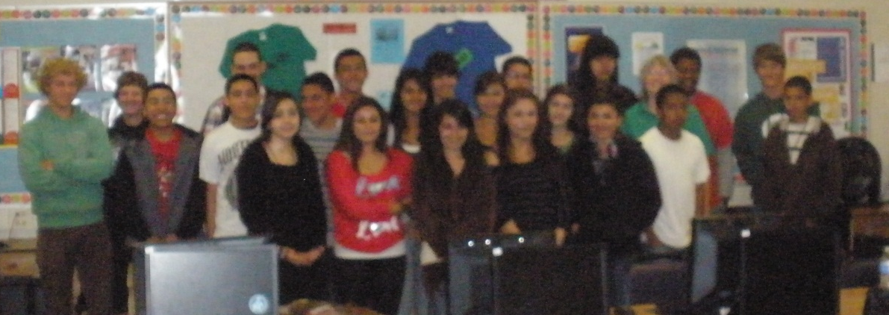
Microloan Project
Short-Term Business
Microloan for products
3 weeks to sell
Students must repay loan
Students keep profits

Slide 11
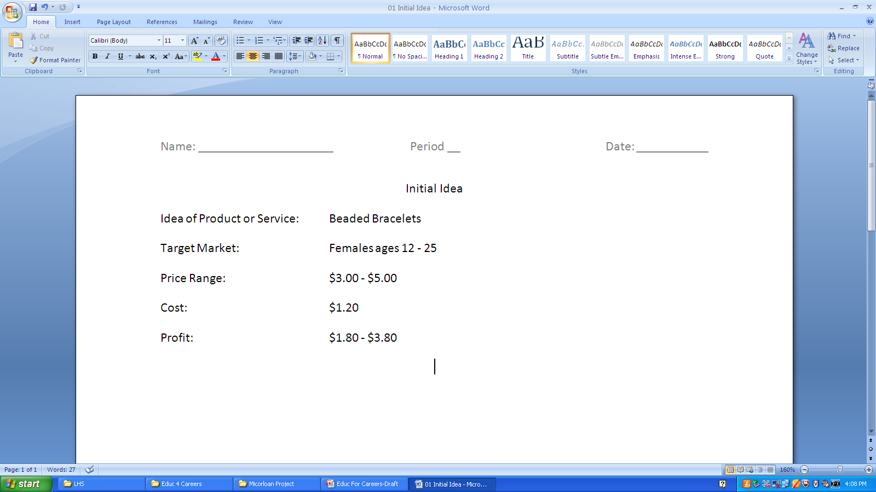
The Next Big Idea

Slide 12

Your IDEAS?
Examples:
Candy, Gum, Chips
Granola Bars
Bottles of Gatorade
Cake Pops
Cupcakes
French Lessons
Homemade Lollipops
Frozen Chocolate Bananas

Slide 13
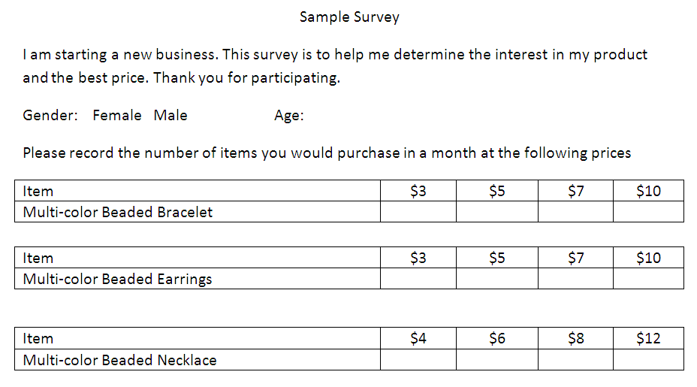
Survey Your Target Market

Slide 14
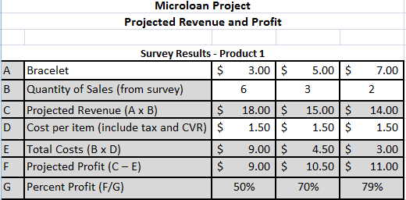
Determine Price Point

Slide 15
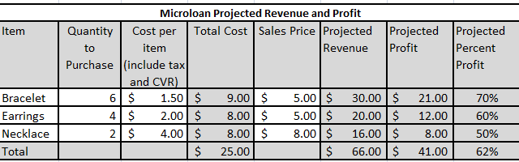
Projected Revenue & Profit

Slide 16
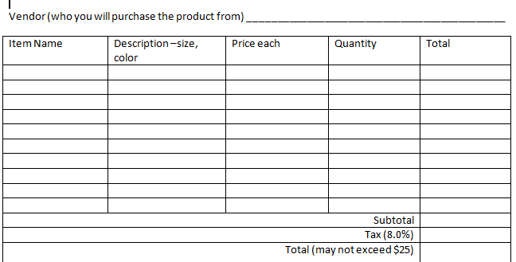
Product Order Form

Slide 17

Shopping: $378.88 – 5 stores
61 different items
519 different pieces
Product order forms required:
  Description of item
  Quantity
  Price per item
  Total investment (>$25.00)

Slide 18
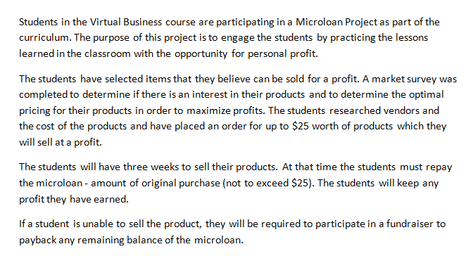
Permission Slip

Slide 19
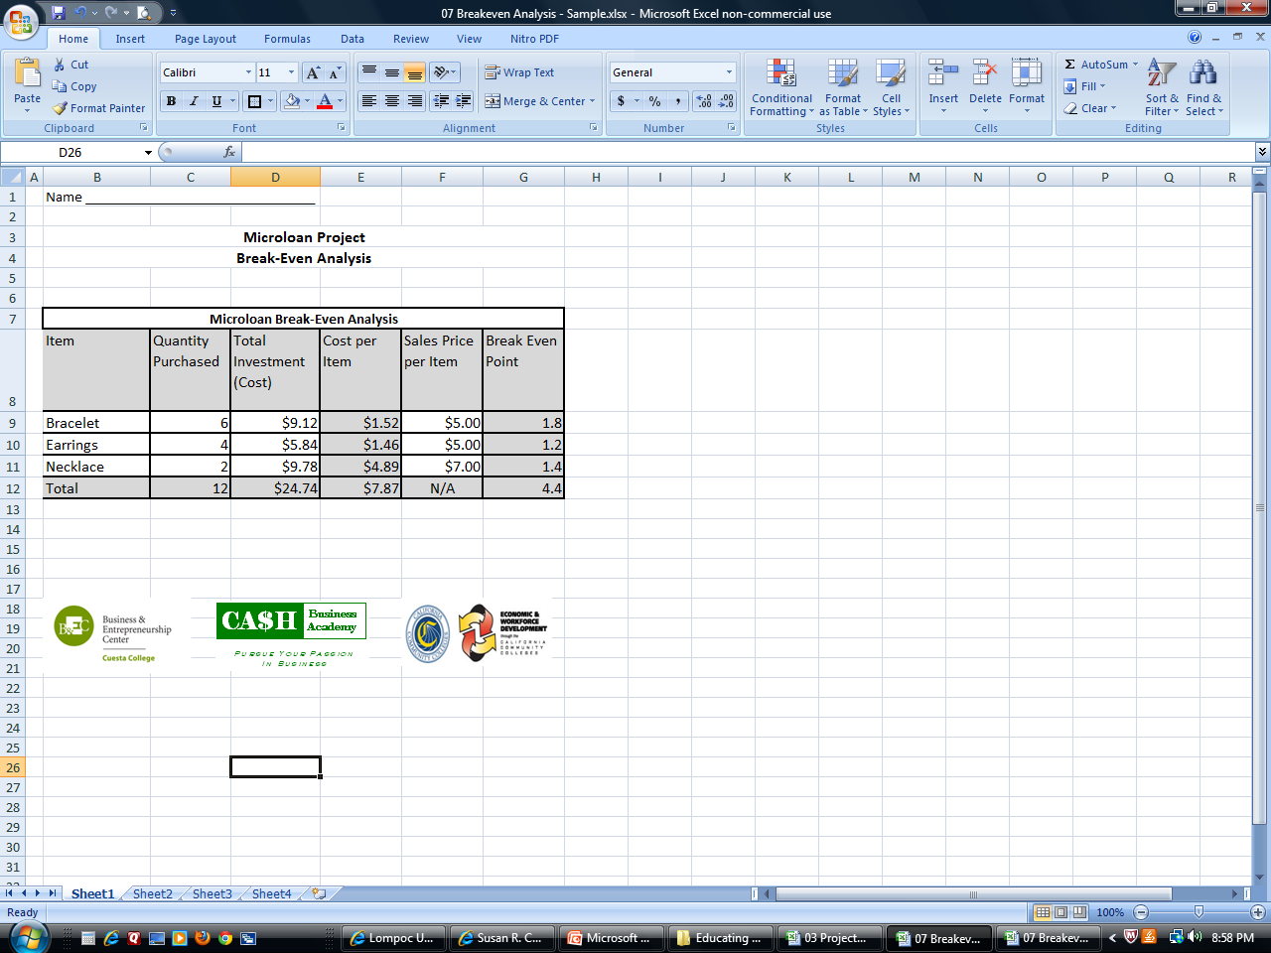
Break-Even Analysis

Slide 20
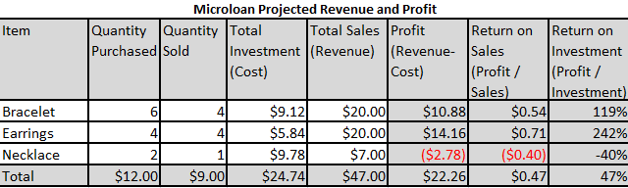
Summary of Revenue & Profit

Slide 21
Grade Sheet
Item | Points Possible | Points Earned
Cover/Title Sheet | 10
Summary | 10
Brand Drawing | 10
Survey | 10
Projected Revenue & Profit | 10
Vendor Order Form | 10
Break Even analysis | 10
Summary of Revenue & Profit | 10
Timeliness | 10
Overall Appeal/Neatness | 10
Total | 100

Slide 22
Microloan Project Results
Submit completed forms and meet one-on-one with Cuesta YEP Coordinator
88% of the students made a profit
68% said they were or maybe were interested in an entrepreneurial career
Classroom ROI – 77%
All funds were paid back!

Slide 23
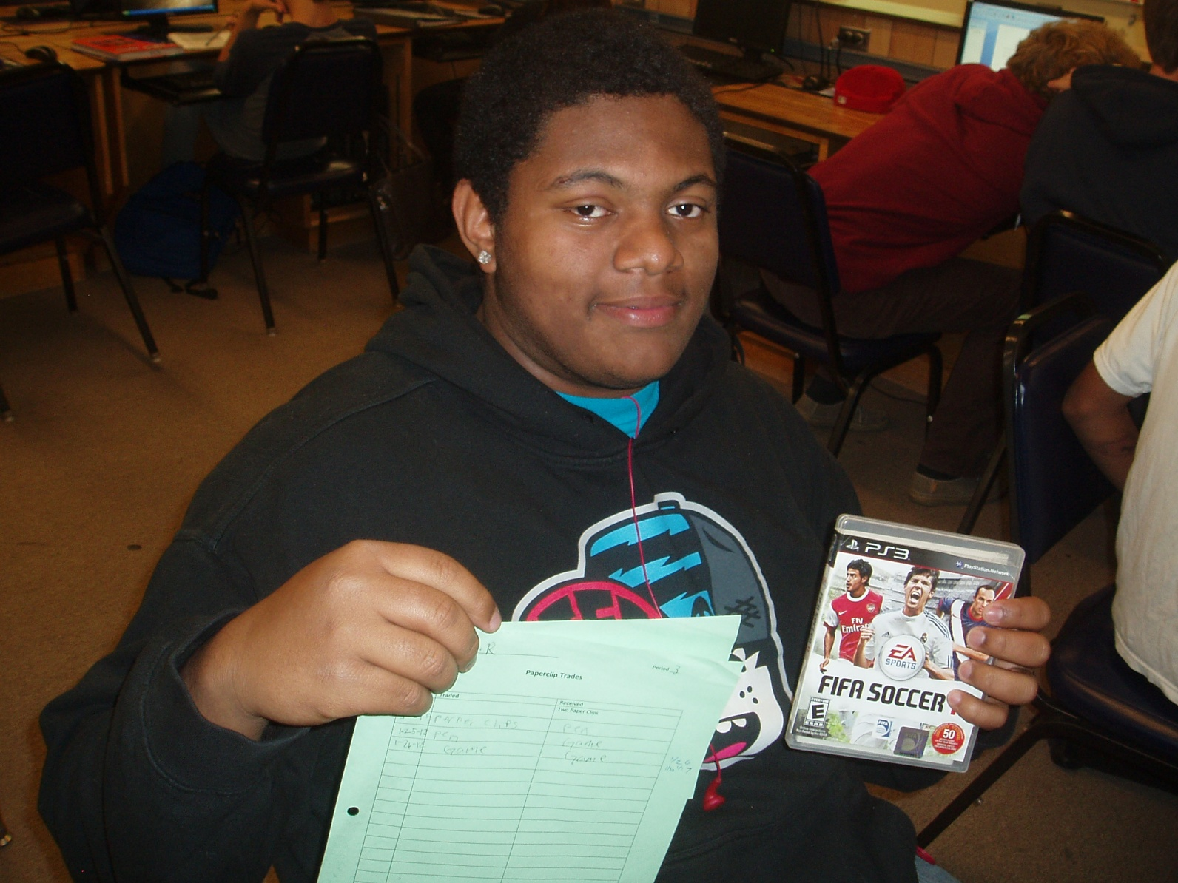
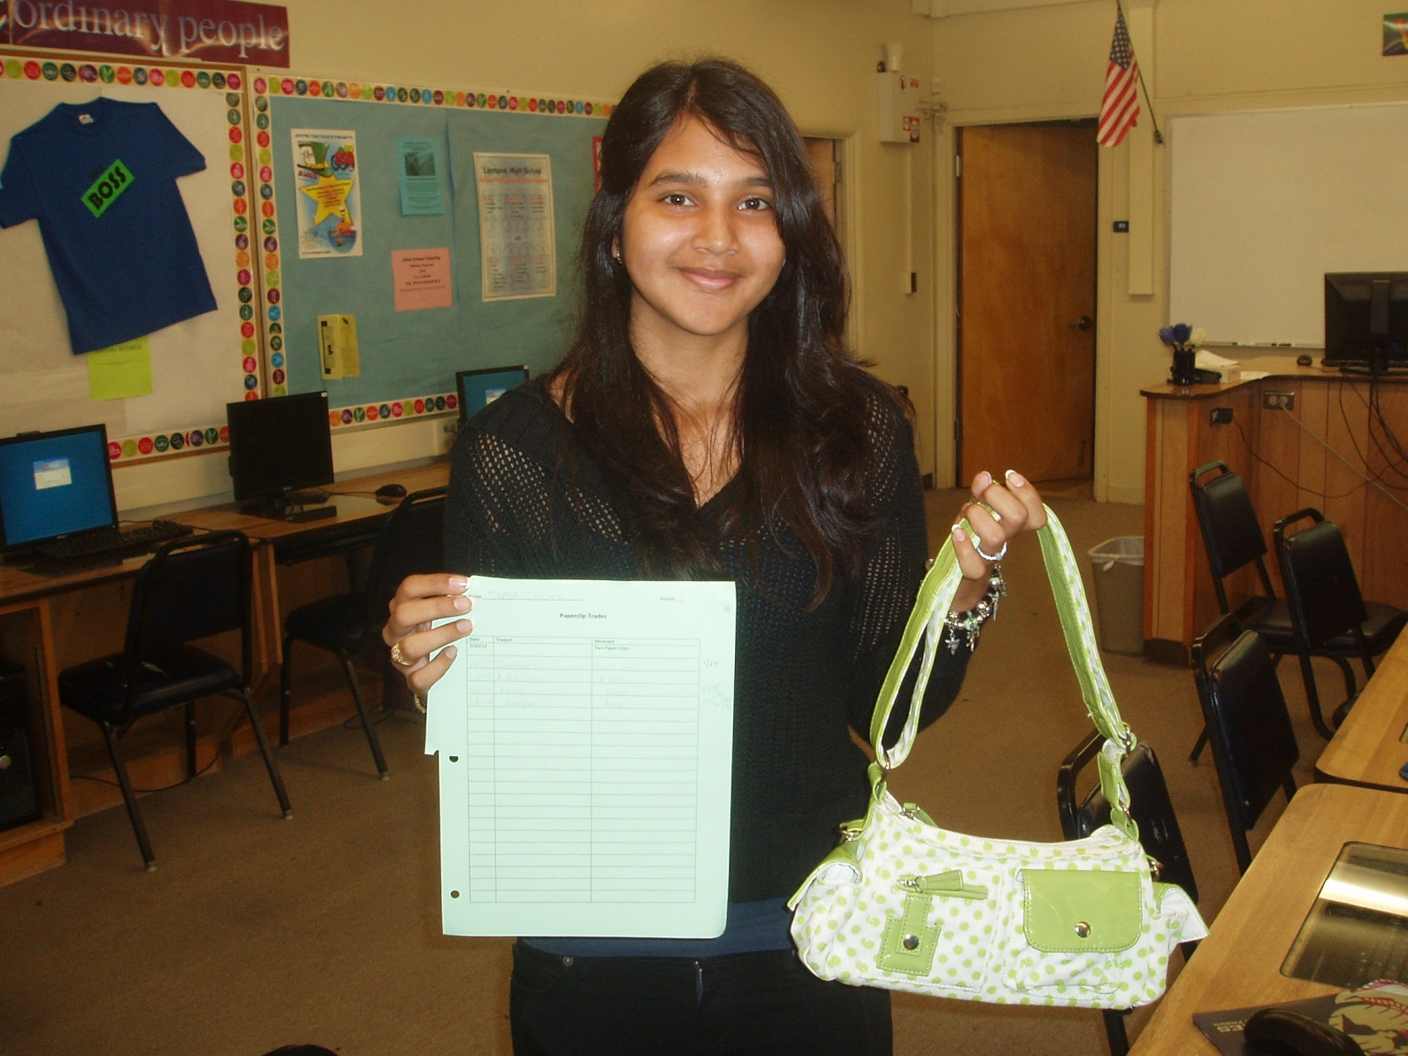
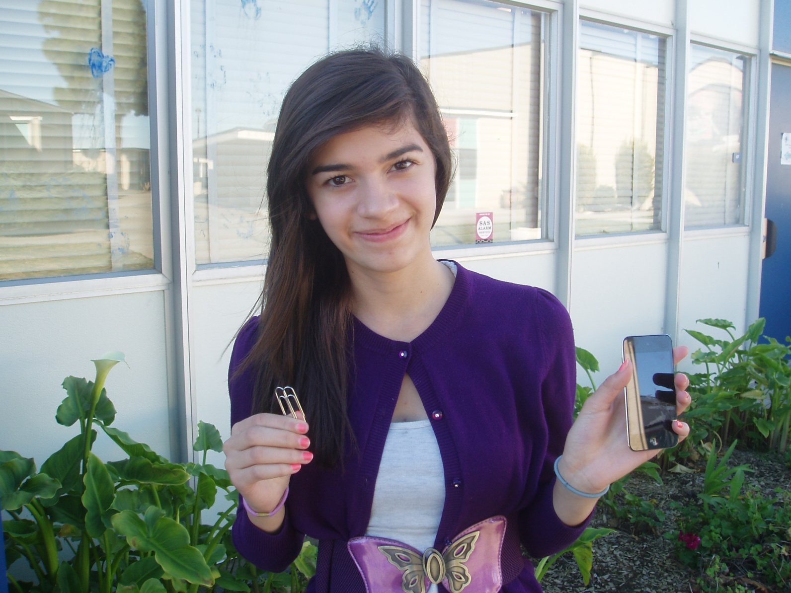
Paperclip Trade

Slide 24
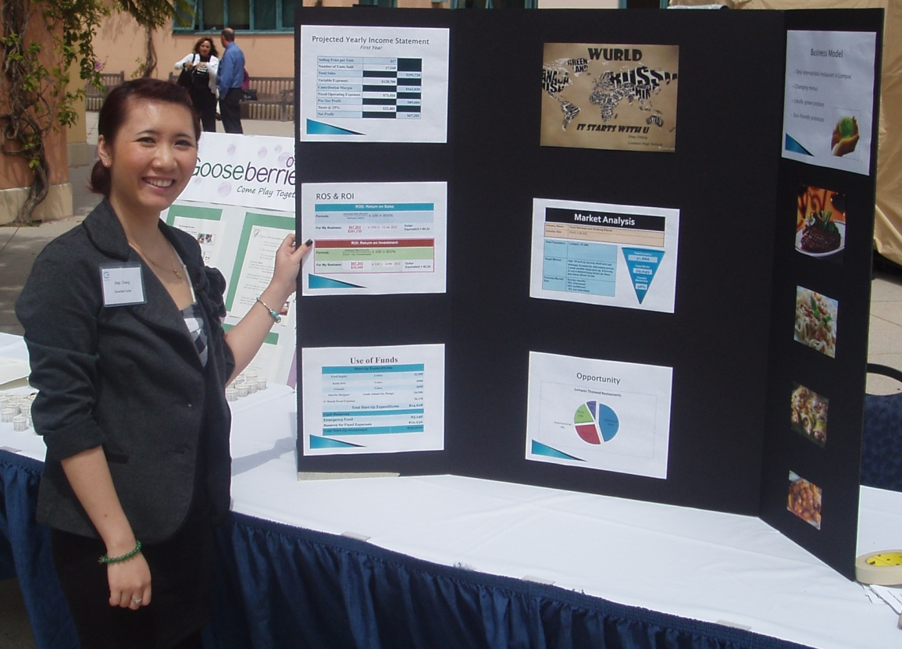
Business Plan Competitions

Slide 25
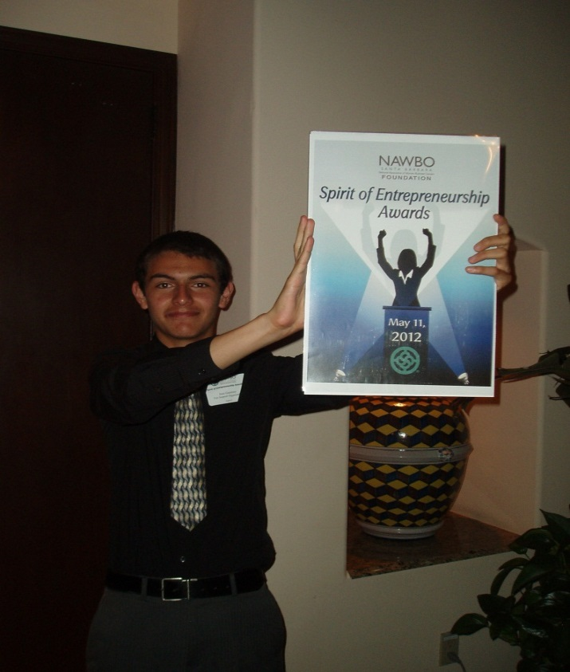

2nd Place Winner at New Venture Challenge, Santa Barbara City College–
FUN SUPPORT ORGANIZATION–
Jose Guerrero, Lompoc High School

Slide 26
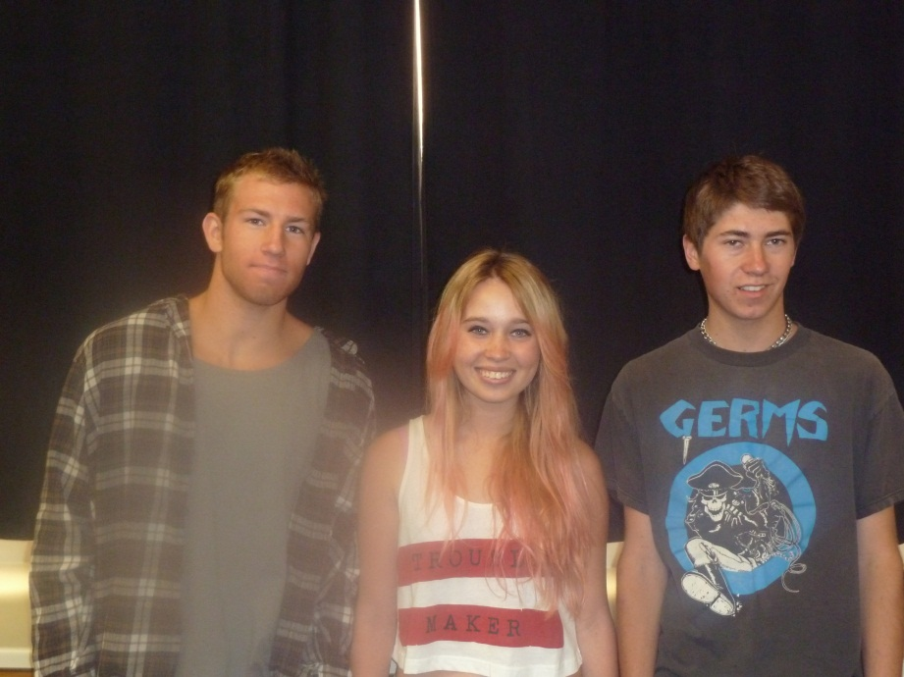
Santa Ynez High School
Presentations
NFTE Student Competition (cash prizes ranging from $100 - $250)
New Venture Challenge Student Competition
NFTE Regional – Lyles Center for Innovation & Entrepreneurship, Fresno

Slide 27

Partnership between the BEC at Cuesta College and Lompoc High School
Thank you,
Sue Coupland
CA$H Business Academy Coordinator
Lompoc High School
coupland.susan@lusd.org

